Slide 1
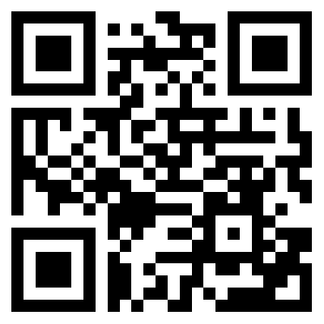
A Structured Pathway to Support, Attract, Retain, and Develop Professionals Involved in End-to-End Sterility
Arthur Dumba &
James Vesper, PhD, MPH
Society for Sterility Assurance Professionals (SfSAP)
To get a copy of these slides (and more!), use this QR code!
https://sfsap.org/conference

Slide 2
What is SfSAP?
Society for Sterility Assurance Professionals (SfSAP)
SfSAP has been established as a collaborative not-for-profit initiative by iia, AAMI, ASTM and PDA. It aims to enable the healthcare industry to:
Collaborate and formulate a standard approach to meeting regulatory requirements related to the competency of those involved in the field of Sterility
Create frameworks that can be used as a career development pathway, that will enable the sterilization community to attract and retain sterility assurance professionals throughout their sterility assurance career.
Assist education delivery organisations in refining and maintaining content that supports the development of individuals in order to demonstrate “competency” as a sterility assurance professional.

Slide 3
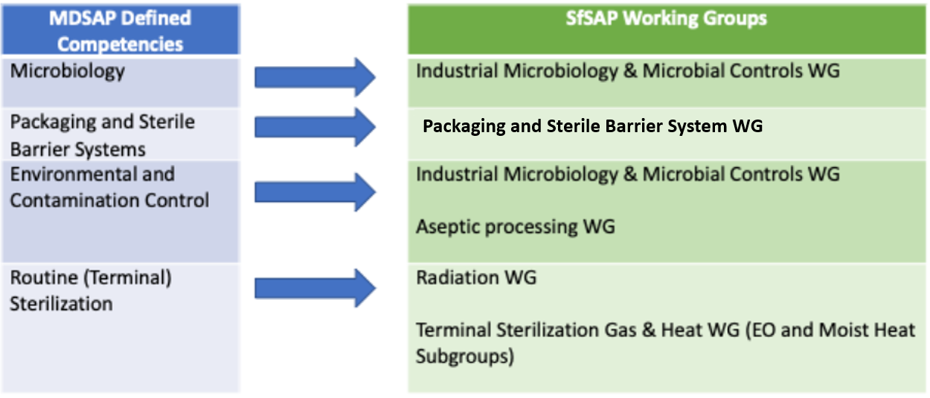
SfSAP Working Groups integration with MDSAP defined competencies
SfSAP Working Groups are aligned with the Medical Device Single Audit Program (MDSAP) Defined competencies
The regulatory requirements are being addressed via the various working groups
6 WG consist of 55 people who represent 30 different healthcare companies.

Slide 4
Competencies of auditors as defined by MDSAP G0002.1004 Companion Document_rev 2017-04-13
It is up to the Auditing Organization to determine the competencies required to achieve the audit objectives and to assign a competent audit team. However, the AO should identify auditors and/or technical experts having the competencies identified below.
The auditing of activities and processes contributing to the sterility of a medical device may involve the following competencies:
Microbiology: Ability to assess the validation of sterilization processes and methods regardless of the availability of an established standard (or the lack of such a standard). Ability to assess the validation of environmental and microbial contamination controls. Ability to assess the validation of packaging activities and sterile barrier systems. A person deemed to have this competency would likely be educated as a medical microbiologist.
Packaging and Sterile Barrier Systems: Ability to assess the validation of activities and processes for packaging and sterile barrier systems.
Environmental and Contamination Control: Ability to evaluate the adequacy of environmental and microbial contamination control programs.
Routine Sterilization: Ability to assess the validation of sterilization processes and methods where an existing established standard on the method exists other than aseptic processes. Ability to verify the implementation of non-standard sterilization activities and processes previously audited by someone having the microbiology competency. Ability to assess the implementation of activities and processes for packaging and sterile barrier systems previously audited by someone having the packaging and sterile barrier systems or microbiology competency. Ability to assess the implementation of environmental and microbial control activities previously assessed by someone having the microbiology or environmental and contamination control competency.
An auditor may possess several of these competencies

Slide 5
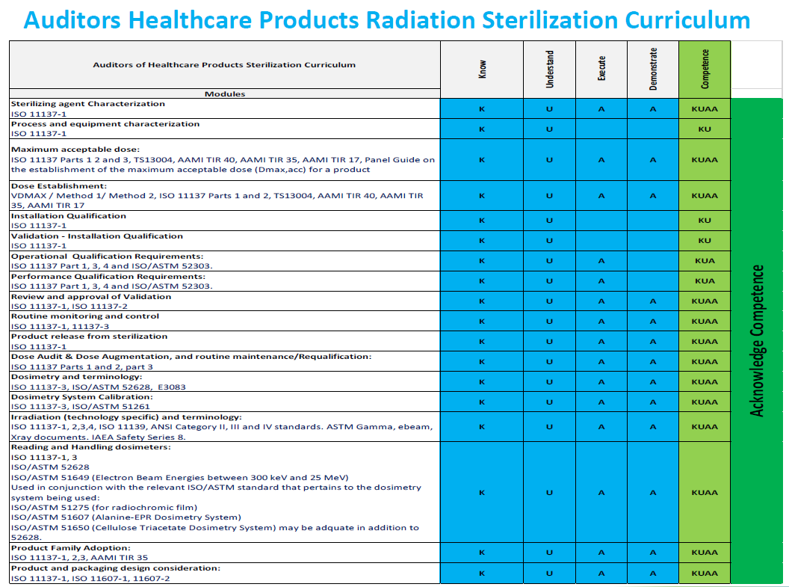
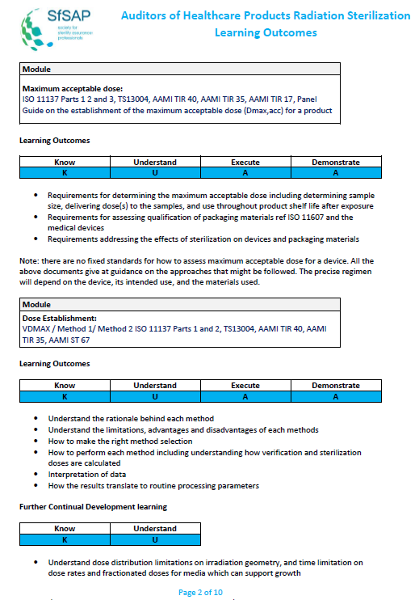
How do we support healthcare quality management requirements?
ISO 13485:2016 Clause 6.2 Requirements to be met by Medical Device Manufacturers
6.2 Human resources
Personnel performing work affecting product quality shall be competent on the basis of appropriate education, training, skills and experience.
The organization shall document the process(es) for establishing competence, providing needed training, and ensuring awareness of personnel.
The organization shall:
a) determine the necessary competence for personnel performing work affecting product quality;
b) provide training or take other actions to achieve or maintain the necessary competence;
c) evaluate the effectiveness of the actions taken;
d) ensure that its personnel are aware of the relevance and importance of their activities and how they contribute to the achievement of the quality objectives;
e) maintain appropriate records of education, training, skills and experience (see 4.2.5).
The SfSAP Learning Framework and Learning Outcomes addresses the requirements for there to be documented evidence of competency and defined in ISO 13485:2016, Clause 6.2 Requirements to be met by Medical Device Manufacturers.

Slide 6
How do we support EU Medical Device Regulations?
MDR Annex VII Requirements to be met by Notified Bodies
3. Resources
3.2 Qualification criteria in relation to personnel
3.2. 1 The Notified Body shall establish and document qualification criteria and procedures for selection and authorization of persons involved in conformity assessment activities, including as regards knowledge, experience and other competency required and the required initial and ongoing training. The qualification criteria shall address the various areas within the conformity assessment process, such as auditing, product evaluation or testing, technical documentation review and decision making, as well as devices, technologies and areas, such as biocompatibility, sterilisation, tissues and cells of human and animal origin and clinical evaluation, covered by the scope of designation.
The SfSAP Learning Framework and Learning Outcomes addresses the requirements for there to be documented evidence of competency and defined in the MDR.

Slide 7
Why have formalized curricula?
Curricula
Organi-zation
Individual
Regulators
Industry
What are we looking for when hiring a new person?
What is the collective set of K&S we need?
How can we help our people grow their K&S?
What experiences will shape one’s competence?
How can we attract new talent?
How can we develop professionals that will be critical to the future of our industry and our patients?
How can we retain professionals who will become industry experts?
If I want to become an expert in this field, what’s my path?
How can I do this in a step-wise manner?
The pathway to expertise
Expert
What is the set of K&S that industry experts and practitioners say are need to be competent as an expert?
What is the collective set of skills a firm needs?
What is the set of education, training, and experiences an expert should have?
Proficient
Competent
Novice
Knowledge, skills, experiences
(Dreyfus Model)

Slide 8
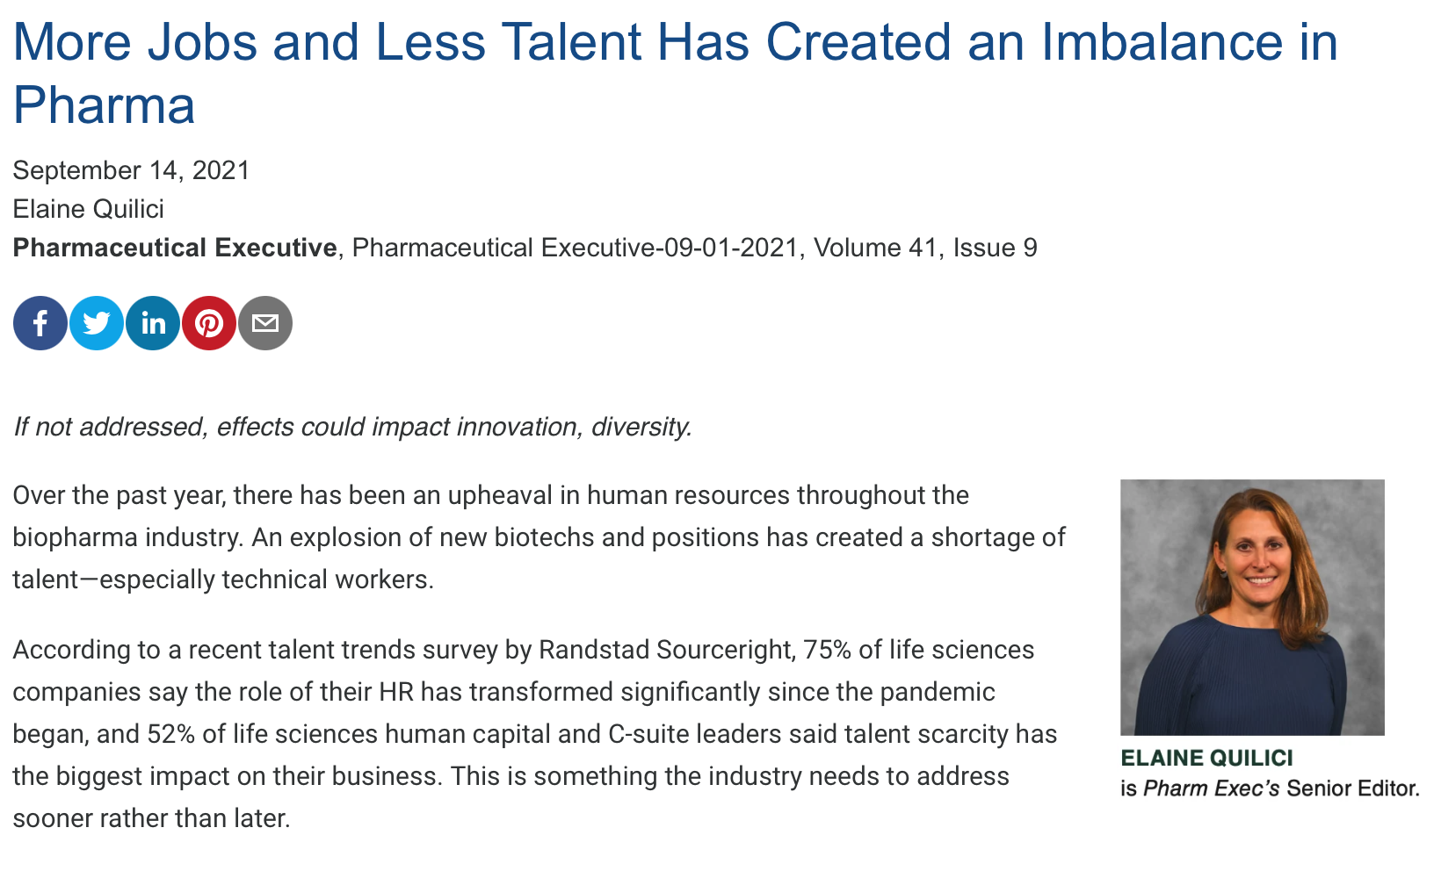
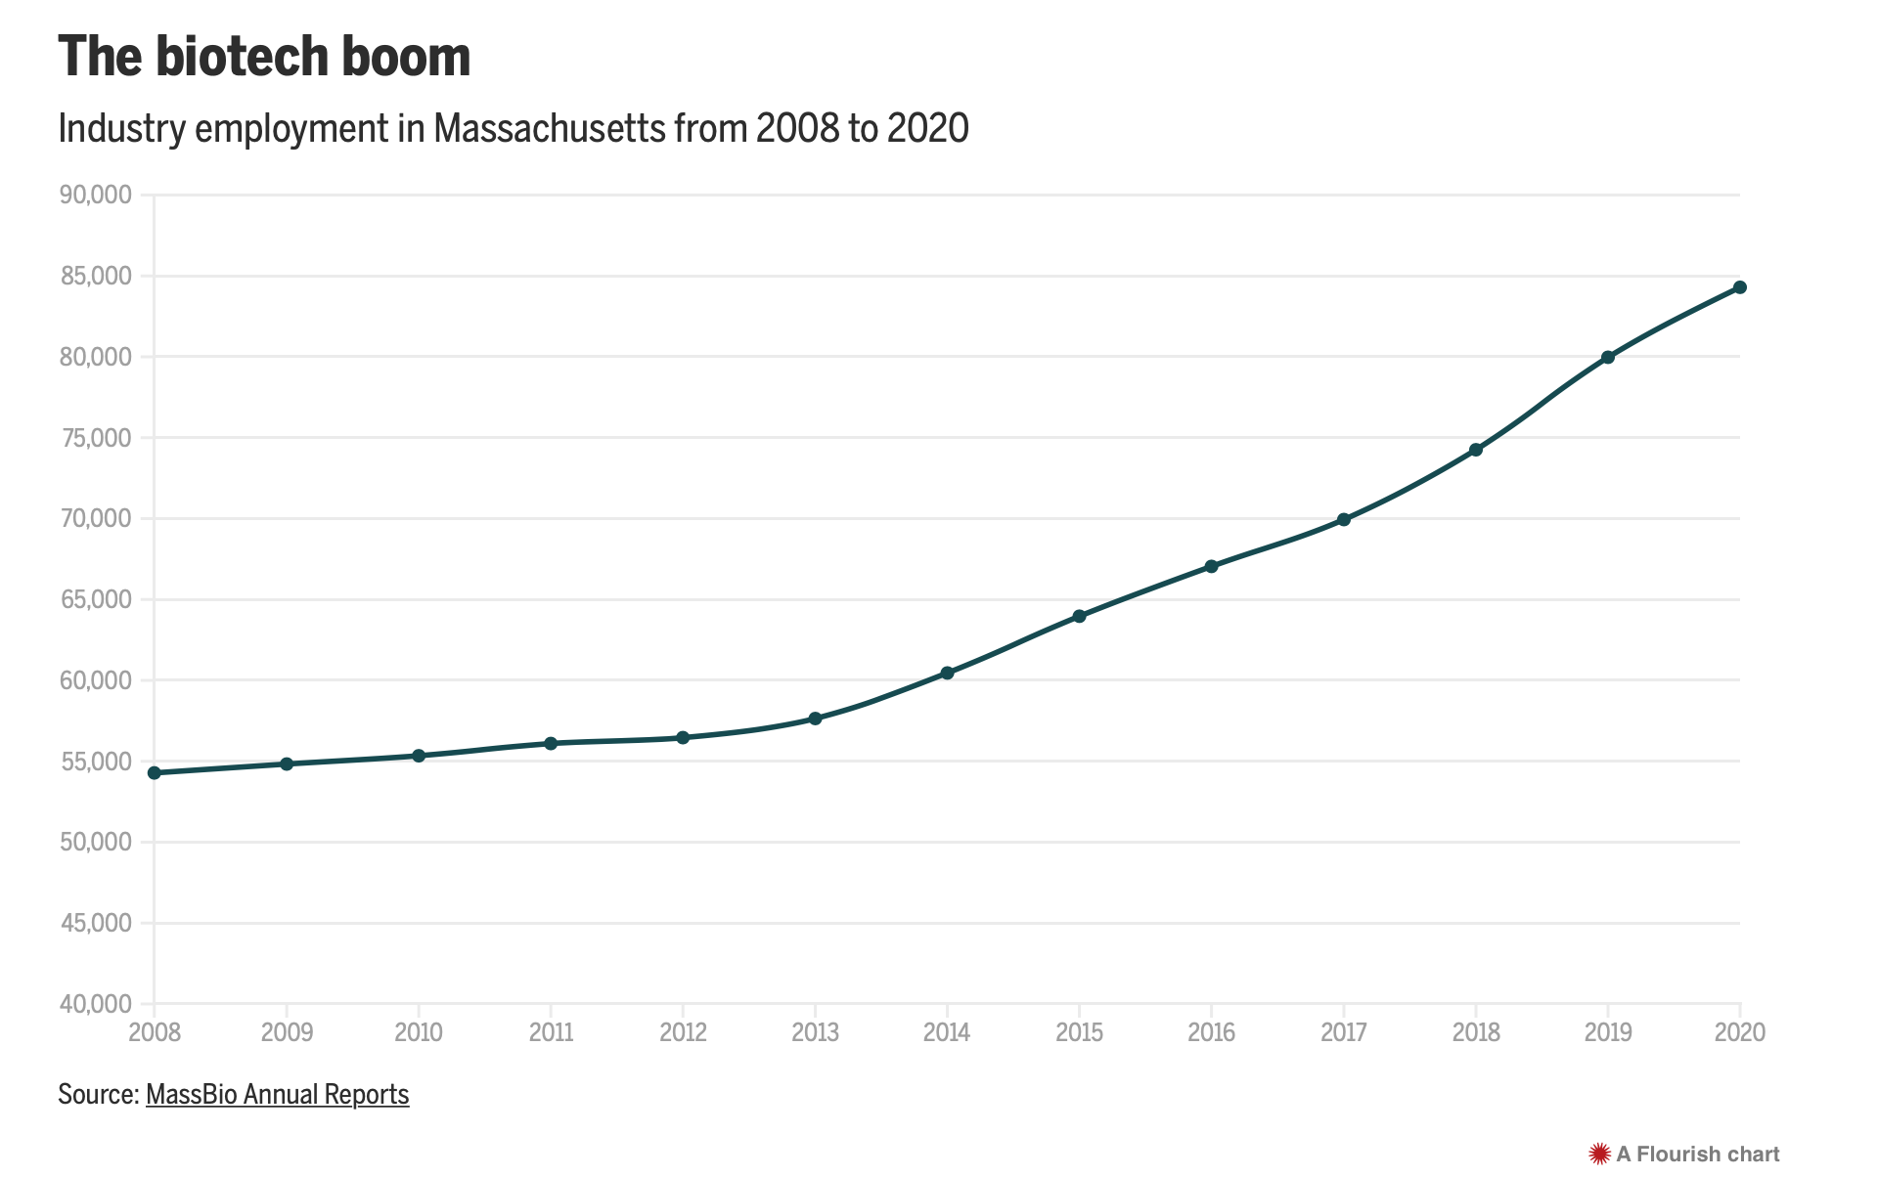
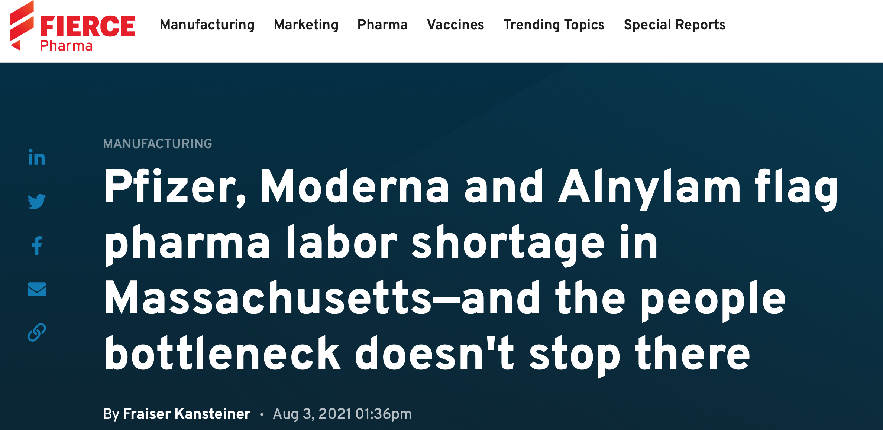
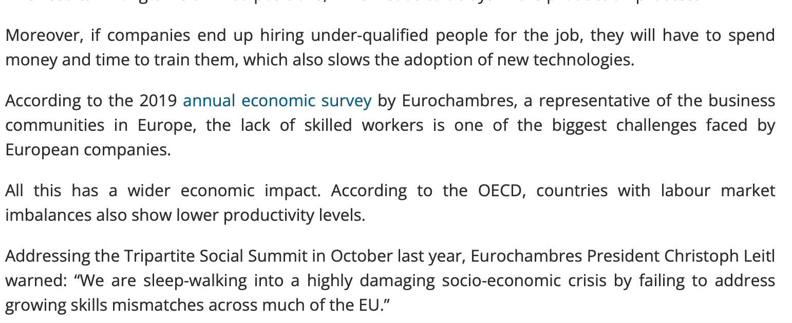
Why is this needed now?
Notes:
The Sterility Assurance community faces the challenge of attracting, retaining and developing professionals involved in E2E sterility

Slide 9
From novice to expert – the Dreyfus Model
Expert
Becoming an expert doesn’t happen all at once – it requires a person to have years (often said to be 10 years) and hundreds of different experiences. Our curriculum map will take this progression into account.
Proficient
Deep understanding of what to do and how to do it; have well-developed mental models and use intuition; when facing a novel situation, can move to analyze situation
Com-petent
No experience; depends on instructor or colleague to explain and provide path into procedures
Clearly sees what is need to reach goal; views situation holistically, actions based on rational deliberation; developing intuition based on experiences
Advanced beginner
Performs more technically challenging work; discovers mechanisms and develops mental models
Novice
Starts seeing examples and creating rules of thumb with instructor or mentor

Slide 10
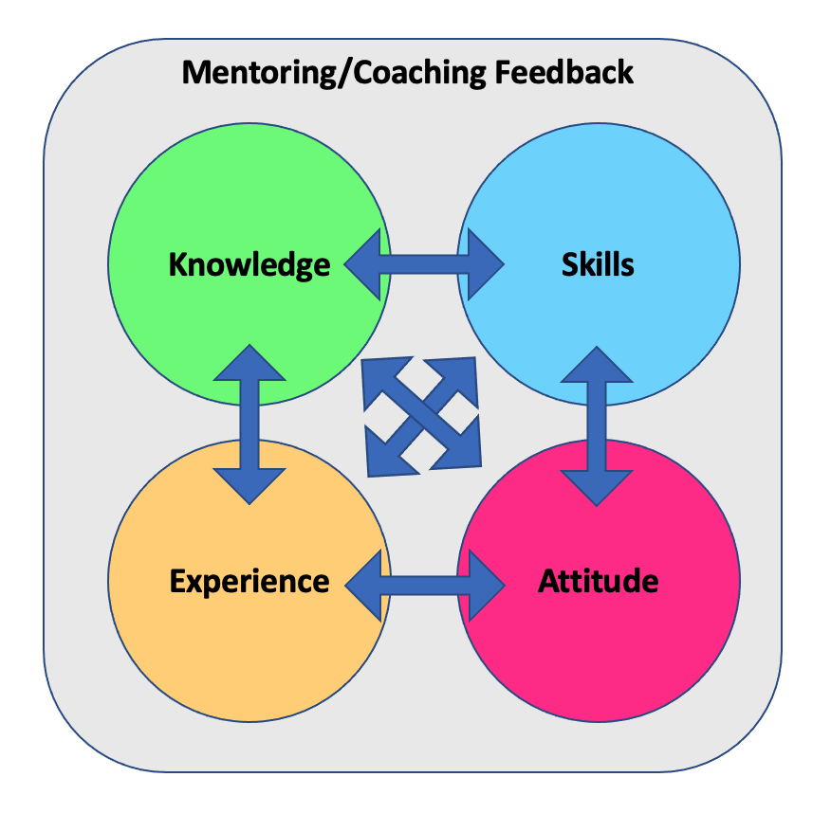
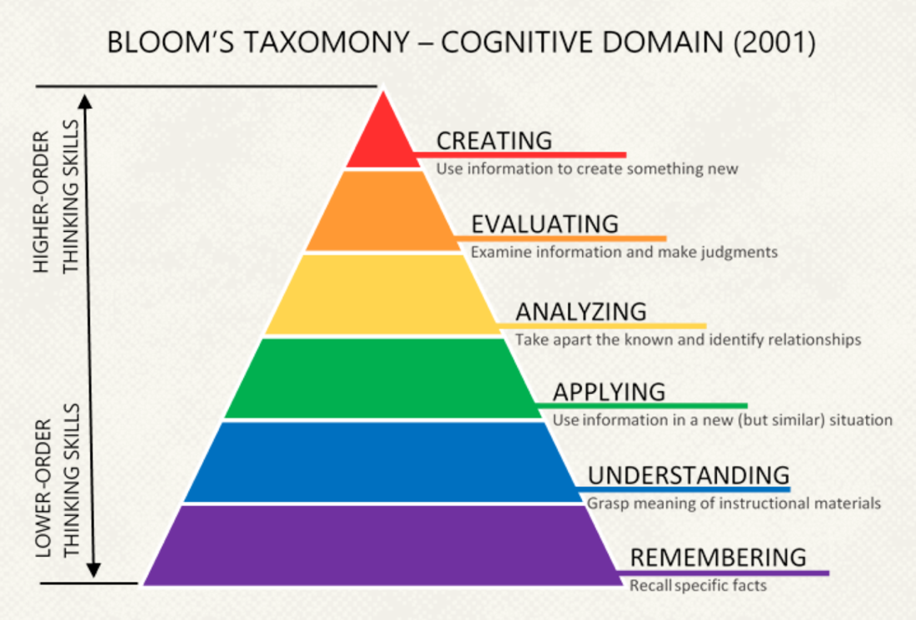
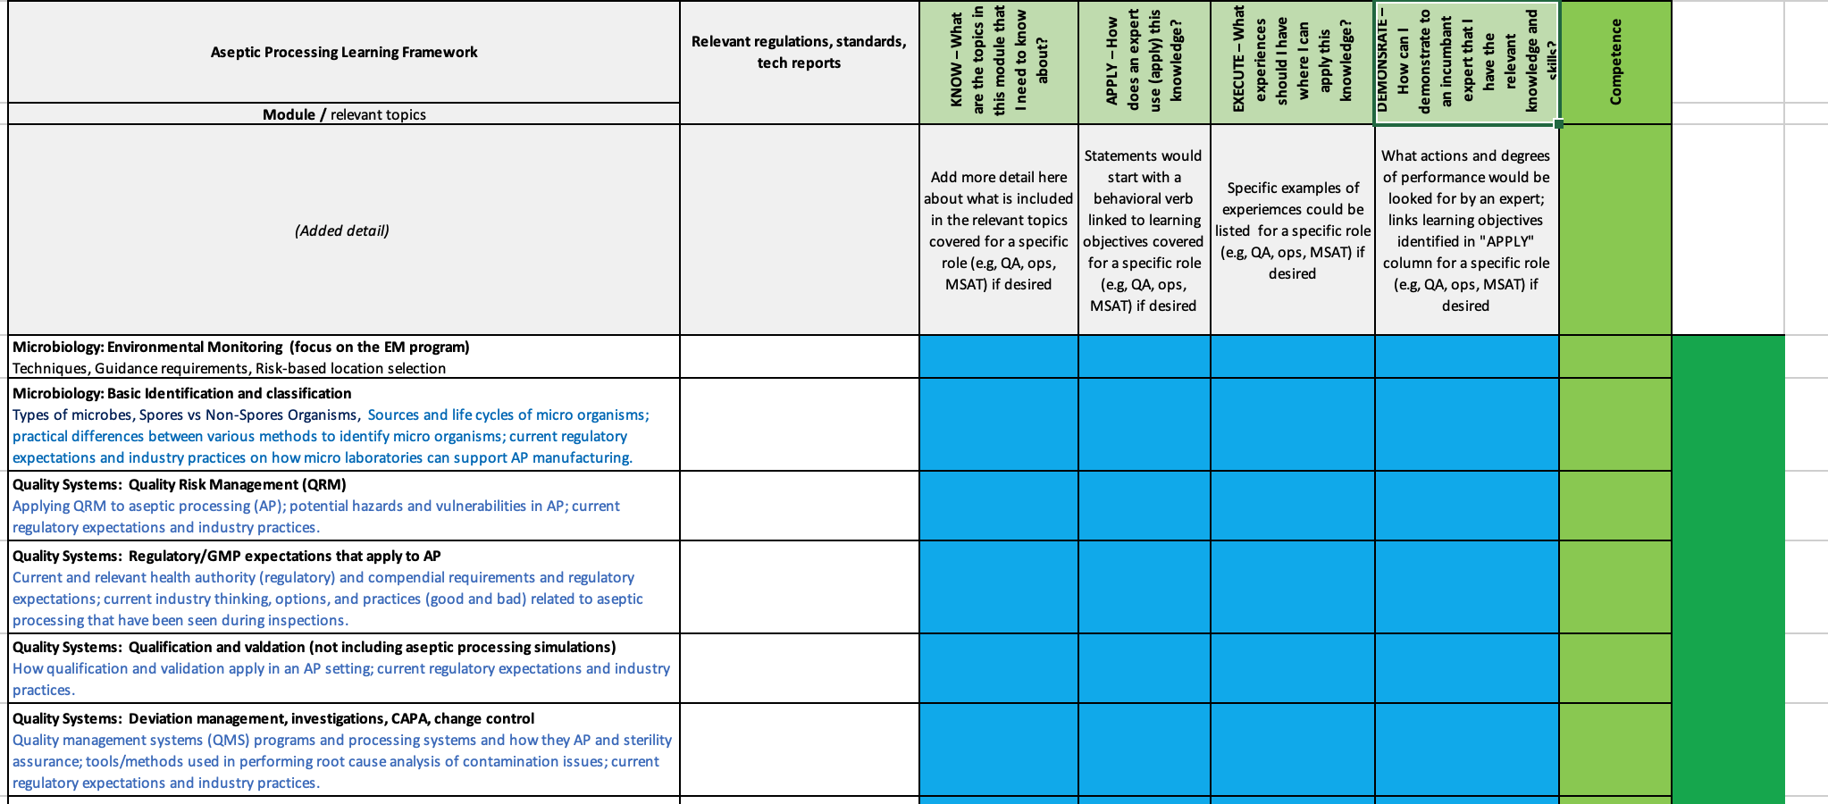
Develop: What contributes to developing expertise
KNOW
What are the topics in this module that one needs to KNOW about?
APPLY
How does an expert use (APPLY) this knowledge in their work?
EXECUTE
What experiences should a developing expert have where they can apply this knowledge?
DEMONSTRATE
How does a learner demonstrate to an incumbent expert or authority that the learner has the relevant knowledge and skills?
Using the Learning Frameworks and Learning Outcomes to support Education Delivery Organisations (EDO) develop training which is in line with the needs of the industry, and support the planning and advancement of sterilization professionals in their careers

Slide 11
Developing thinking (cognitive) skills
For example:
Expertise associated more at the higher levels
I can create a validation protocol that is technically correct and meets regulatory expectations.
I can evaluate an operational procedure to determine if it is technically correct.
I can analyze a failure and provide ideas on what might have gone wrong.
I can apply my understanding in preparing a loading configuration for new equipment.
I understand why the loading configuration is important to achieving sterility.
I remember how to correctly load the autoclave.

Slide 12
How one develops expertise, 1
Knowledge. This involves having the foundational knowledge and understanding the principles involved with microbial contamination and ways to prevent it. This knowledge is the basis for actions and decisions. Subject matter experts who developed the curriculum have identified topics and subtopics of knowledge that a sterility professional in a particular role should have.
Skills. Skills include thinking or “cognitive” skills that are used in many different ways – making decisions, considering risks, evaluating situations, analysing new problems, and developing plans and protocols. The subject matter experts who developed the curriculum have identified certain skills that a sterility professional in a particular role should be able to demonstrate.

Slide 13
How one develops expertise
Attitude. While harder to teach, attitudes are usually observed and absorbed by someone in a given line of work so that they are effective in what they do. This is the professionalism one needs – for example, being prepared, not taking shortcuts, being concerned for the patient, being diligent, and not giving up too soon.
Experience. A characteristic of an expert is that they have had a variety or repertoire of experiences that they can draw on – the more you do, the better you get. The opportunity that you (and your management) have is finding opportunities where you can apply ­– and expand – your knowledge and skills through different experiences.
Feedback from mentors and coaches. One of the most important factors in becoming an expert is having people who will provide feedback – helping you stay on the correct course or giving you constructive criticism that helps you understand where you may have been off track. You might have different mentors or coaches for different facets of your work; they could be supervisors or colleagues that are more knowledgeable than you are in each aspect of sterility assurance.

Slide 14
Retain: A range of possibilities being considered
Qualify
Person has met requirements allowing them to adequately perform role
Qualified to work in an aseptic processing area, qualified to use a laboratory instrument
License
Person has been given permission by a governmental body to perform defined actions
Driver’s license, medical license
Certify
Person has been confirmed that they initially and continue to meet the standards set by a body of recognized professionals, experts
Certified public account, certified by a board of medical practice
Give those sterility assurance professionals industry recognised credentials.

Slide 15
Develop: One idea – document knowledge, skill, experience: Portfolios
Courses / education completed (Certificates of completion, course titles and course outlines)
Relevant work experiences
(Specific problems / solutions and activities that were performed [”executed”])
Portfolio
Resume / CV
Curriculum checklist (summary of knowledge, skills, experiences accomplished, examples of work products)
Work history
(Job titles and job descriptions)
Contributions to the profession
(Articles or book chapters, standards written, membership in associations)

Slide 16
Acknowledged Competency
Know
Apply
What are the topics in this module that an expert in this domain needs to know and understand about?
Build foundation of knowledge in scientific area associated with the sterilization modality
Network with experience users of the science associated with the sterilization modality
How does an expert use (apply) this knowledge?
Can vary based on the role of the person (e.g., QA, engineering, MSAT)
Statements begin with a behavior verb (e.g., ‘discuss’, ‘assess’) that can become a learning objective
Knowledge and skill learning opportunities can come from a variety of sources
Applying can depend on the role the indivual has
Execution emphasises the practical nature of learning
Demonstration may be to a variety of knowledgable persons
Global industry experts identify knowledge and skills needed by experts in that field
Execute
What are specific examples of experiences could be listed whereby someone develops a “repertoire of experiences”?
Could include short- or long-term projects, work experiences, product types
For example, ”Uses risk assessment to define an environmental monitoring (EM) program.”
Demonstrate
How can someone demonstrate to an incumbent expert or authority that they have the relevant knowledge and skills?
This is intended to provide confidence to an organization, regulatory authority, colleagues and the individual that they have the needed knowledge and skills to be successful in the specific field of interest.

Slide 17
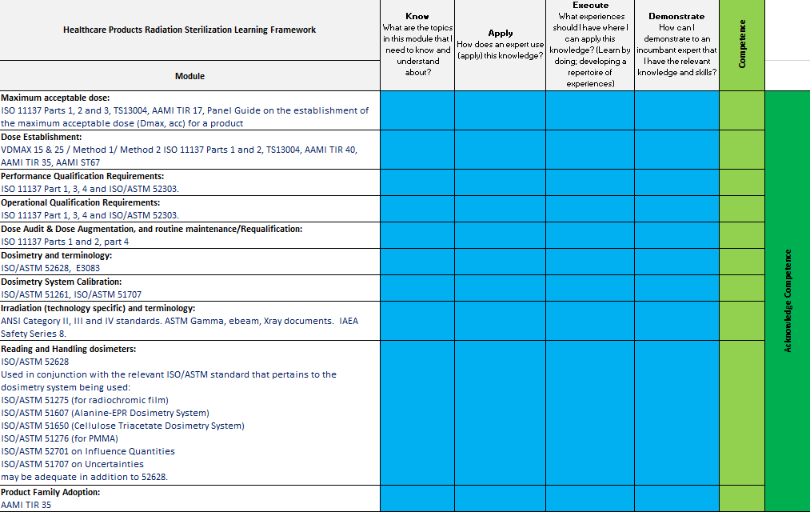
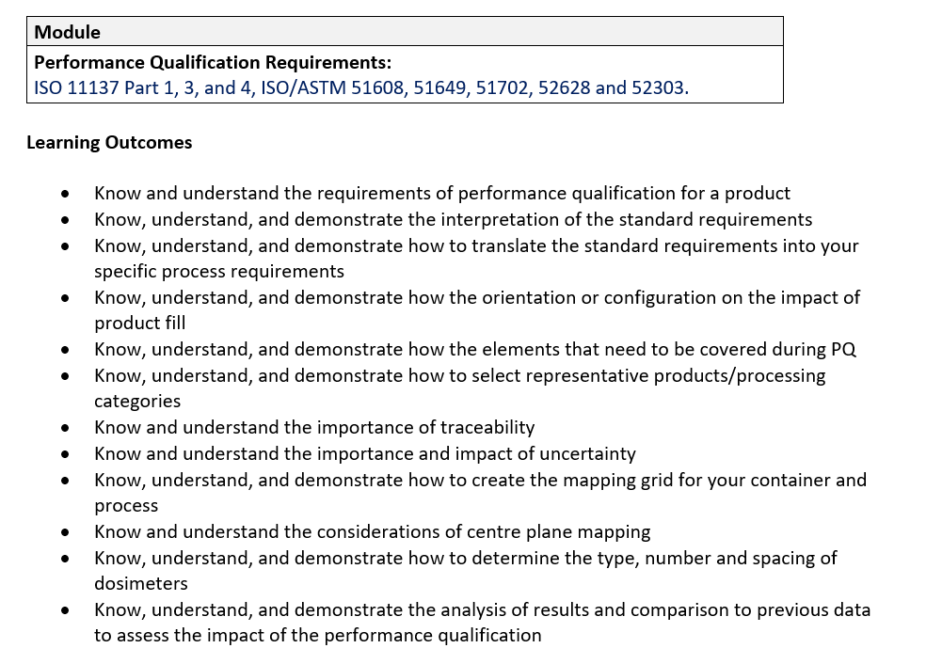
Link Framework to Outcomes
Supportive Slide

Slide 18
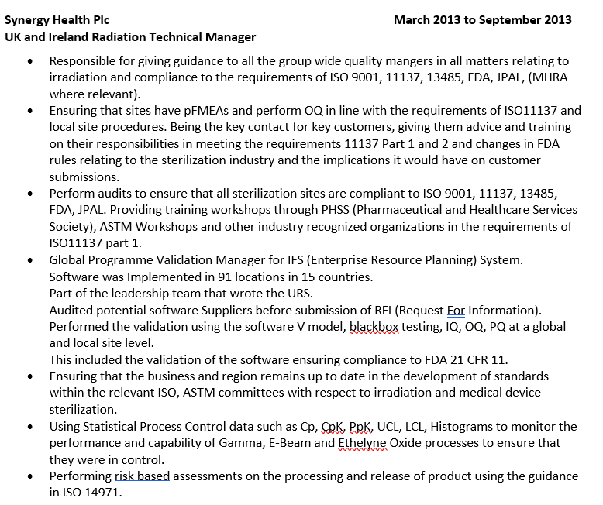
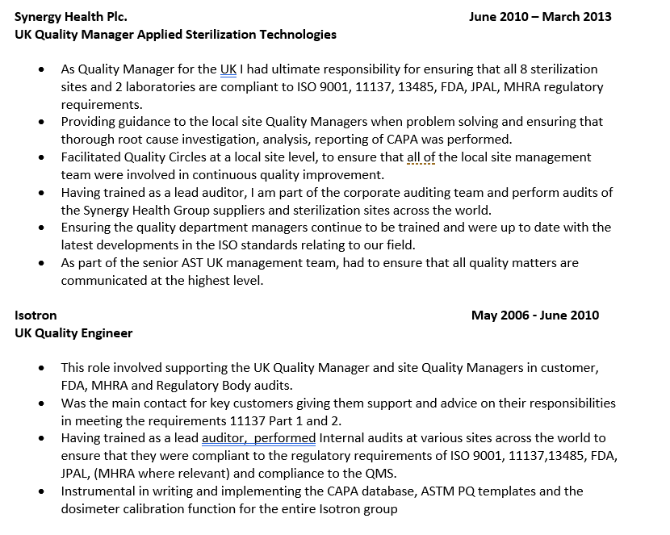
Building your portfolio
Supportive Slide

Slide 19
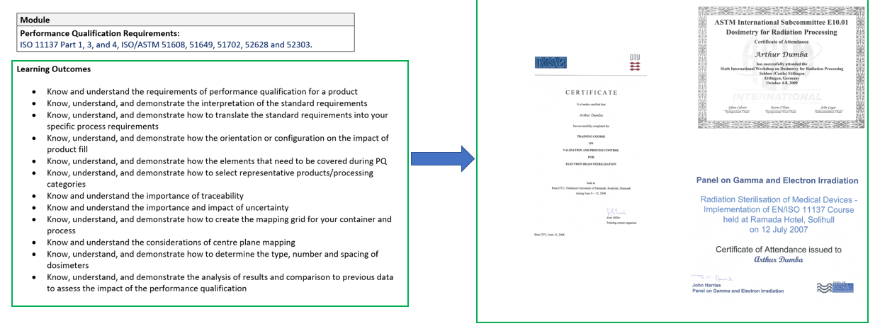
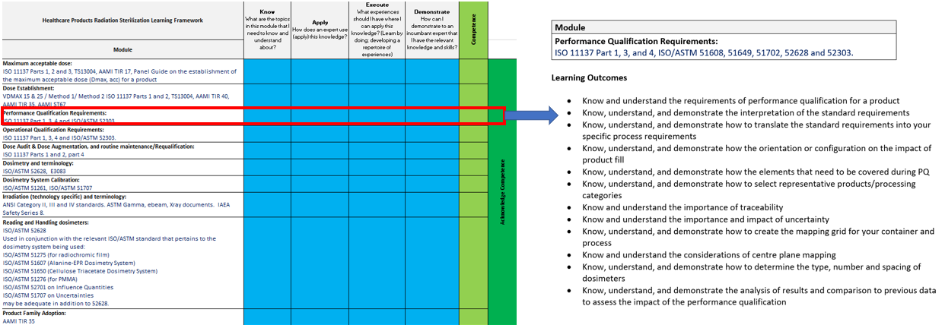
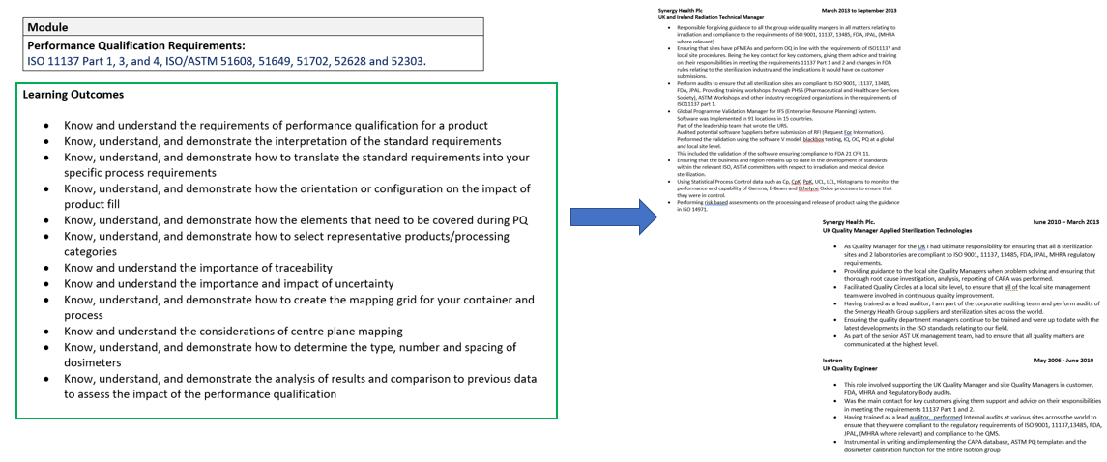
Attract: Create, plan and evaluate pompetency
The frameworks support the healthcare sterilization industry in the following ways:
Assists individuals to create, plan and advance their careers.
Supports employers meet regulatory requirements by providing career development pathways for staff.
Support regulators in helping them determine the elements of training required to meet competency as defined in the MDSAP.

Slide 20
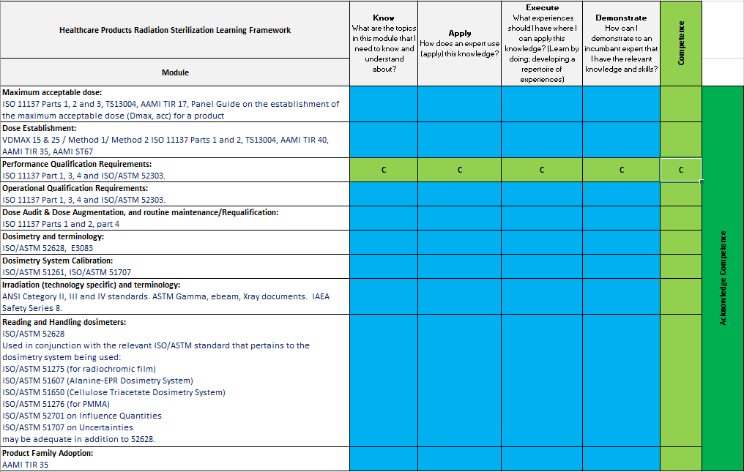
Competency assessment
Supportive Slide

Slide 21
Individuals/organizations using the learning frameworks and learning outcomes
To support individuals and organisations in gaining the appropriate education, training, skills and experience the SfSAP has a Learning Outcomes Guide:
Individuals and Organizations
The SfSAP Curricula and learning outcomes can be use by individuals and organisations for the following:
Develop training plans
Determine training courses that should be attended
Understand the Competency elements (Know, Apply, Execute and Demonstrate) that are required.
Understand the learning outcomes required for courses attended or training taken.
Monitor progress towards demonstrating competency.

Slide 22
Continuing our path forward
What SfSAP is working on:
Refining learning frameworks and learning outcomes
Identifying activities (e.g., auditing, designing facilities) that would then be mapped to items in the frameworks and outcomes
Working with experts to identify key experiences important in developing expertise
Categorizing framework items and outcomes that provide a three-level, step-wise approach for moving through the curriculum
“Validating” competency curricula with experts
Sharing the model and results with industry, regulators, and training / educational organizations

Slide 23
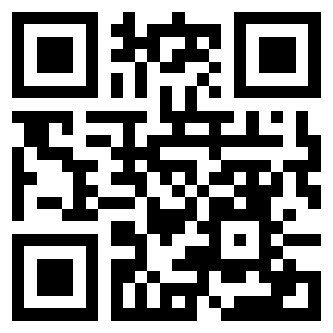
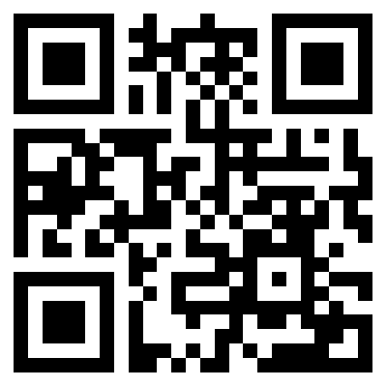
Give us feedback!
Try it!
Five simple questions
https://sfsap.org/insight/
For an individual
For your organization
https://www.sfsap.org/survey/
Apply the framework and outcomes to a person in your organization. Where are they in their progress to being an expert? What are the gaps?
Apply the framework and outcomes to your organization. Does your organization collectively have the expertise that it needs? What are the gaps?
Did you find the framework and outcomes useful?
How can it be improved?
What benefits would this provide individuals as they develop their knowledge and skills?
What benefits would it provide your organization?
Would you use it?

